Slide 1

Basics of Neural Network Programming
Computation Graph
deeplearning.ai

Slide 2
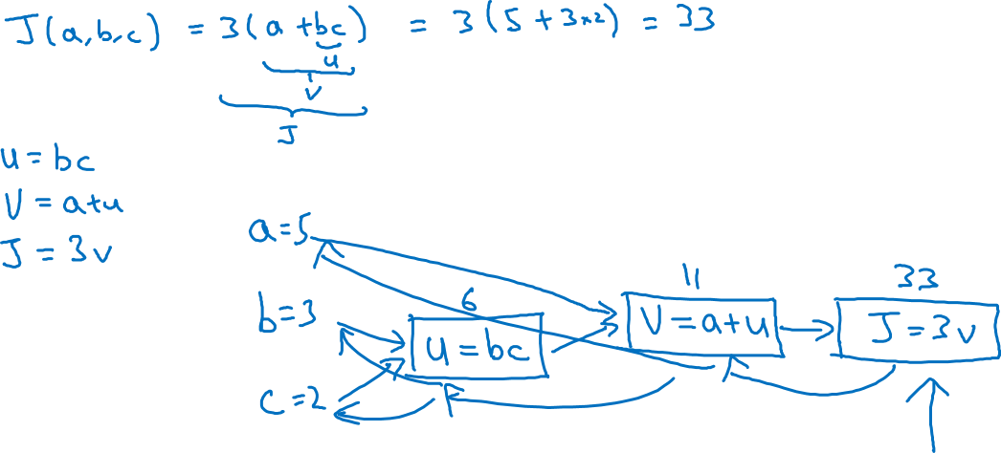
Computation Graph

Slide 3
Basics of Neural Network Programming
Derivatives with a Computation Graph
deeplearning.ai

Slide 4
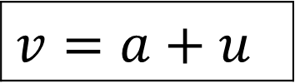

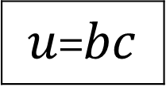



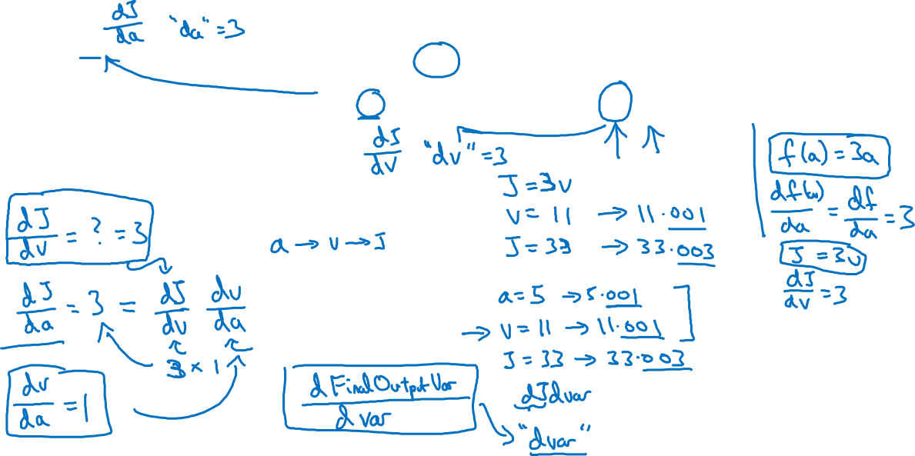
Computing derivatives
$$a=5$$
11
33
$$b=3$$
6
$$v=a+u$$
$J=3v$
$u$=$bc$
$$c=2$$

Slide 5
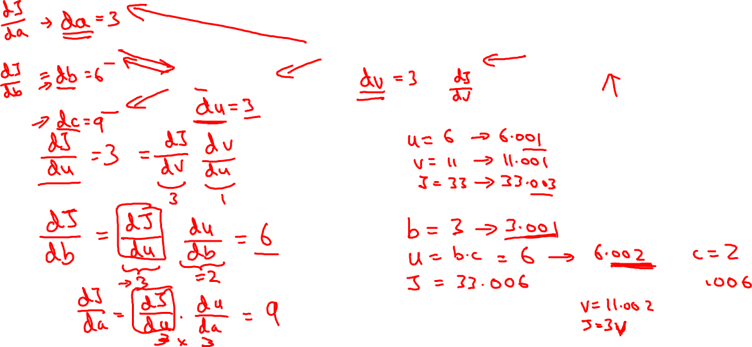
Computing derivatives
$$a=5$$
11
33
$$b=3$$
6
$$v=a+u$$
$J=3v$
$u$=$bc$
$$c=2$$

Slide 6
Basics of Neural Network Programming
Logistic Regression
Gradient descent
deeplearning.ai

Slide 7
Logistic regression recap
$$z= w^{T}x+b$$
$$\hat{y}=a= σ(z)$$
$$ℒ\left(a,y\right)=−(y\log{(a)+(1−y)\log{(1−a))}}$$

Slide 8


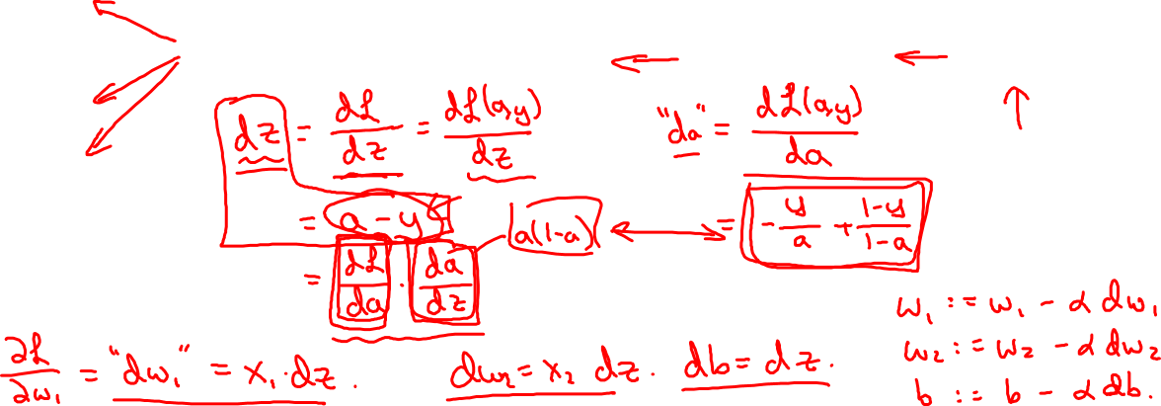
Logistic regression derivatives
$$x_{1}$$
$$w_{1}$$
$$x_{2}$$
$$z= w_{1}x_{1}+w_{2}x_{2}+b$$
$$a= σ(z)$$
$$ℒ(a,y)$$
$$w_{2}$$
b

Slide 9
Basics of Neural Network Programming
Gradient descent
on m examples
deeplearning.ai

Slide 10
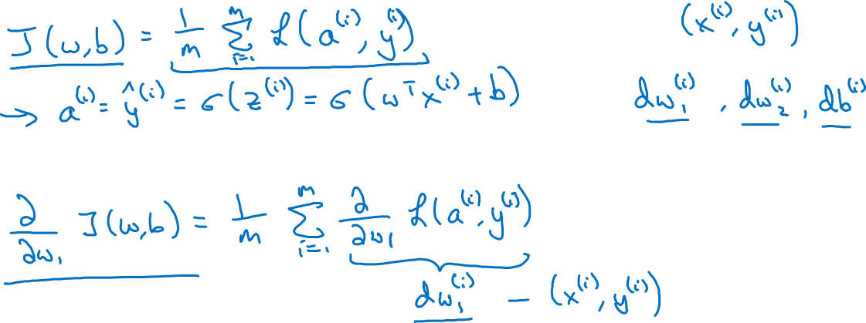
Logistic regression on m examples

Slide 11
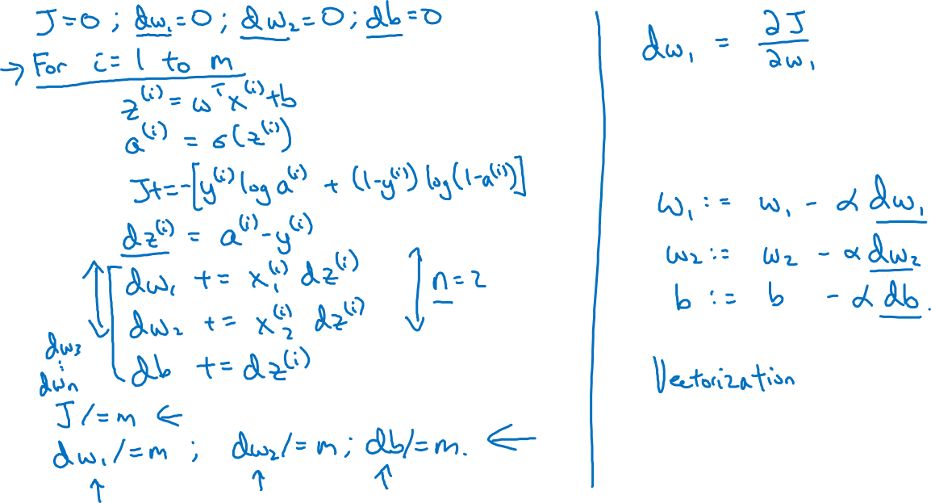
Logistic regression on m examples

Slide 12
Basics of Neural Network Programming
Vectorizing Logistic
Regression
deeplearning.ai

Slide 13
Vectorizing Logistic Regression
$$z^{(1)}=w^{T}x^{(1)}+b$$
$$z^{(2)}=w^{T}x^{(2)}+b$$
$$z^{(3)}=w^{T}x^{(3)}+b$$
$$a^{(1)}={σ(z}^{(1)})$$
$$a^{(2)}={σ(z}^{(2)})$$
$$a^{(3)}={σ(z}^{(3)})$$

Slide 14
Basics of Neural Network Programming
Vectorizing Logistic
Regression’s Gradient
Computation
deeplearning.ai

Slide 15
Vectorizing Logistic Regression

Slide 16
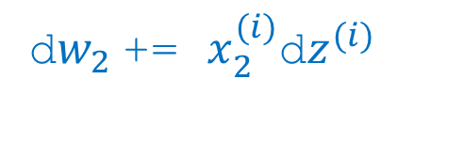
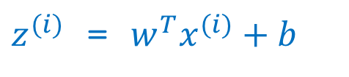


Implementing Logistic Regression
J = 0, d$w_{1}$ = 0, d$w_{2}$ = 0, db = 0
for i = 1 to m:
$z^{(i)}$ = $w^{T}x^{(i)}+b$
$a^{(i)}$ = $σ{(z}^{(i)})$
$J$+= $−\left[y^{(i)} \log{a^{\left(i\right)}+({1−y}^{\left(i\right)})\log{(1 −a^{\left(i\right)})}}\right]$
d$z^{(i)}$ = $a^{(i)}{−y}^{(i)}$
d${w_{1}}^{ }$+= $x_{1}^{(i)}\text{d}z^{(i)}$
d${w_{2}}^{ }$+= $x_{2}^{(i)}\text{d}z^{(i)}$
db += d$z^{(i)}$
J = J/m, d$w_{1}$ = d$w_{1}$/m, d$w_{2}$ = d$w_{2}$/m
db = db/m

Slide 17
Basics of Neural Network Programming
Broadcasting in
Python
deeplearning.ai

Slide 18
Broadcasting example
Calories from Carbs, Proteins, Fats in 100g of different foods:
Apples
Beef
Eggs
Potatoes
Carb
$$\left[\begin{matrix}56.0 & 0.0 & \begin{matrix}4.4 & 68.0\end{matrix} \\ 1.2 & 104.0 & \begin{matrix}52.0 & 8.0\end{matrix} \\ 1.8 & 135.0 & \begin{matrix}99.0 & 0.9\end{matrix}\end{matrix}\right]$$
Protein
Fat
cal = A.sum(axis = 0)
percentage = 100*A/(cal.reshape(1,4))

Slide 19
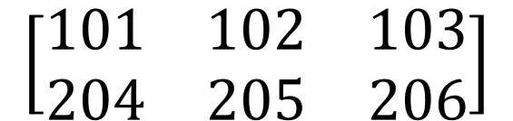
Broadcasting example
$$\left[\begin{matrix}1 \\ \begin{aligned}\begin{matrix}2 \\ 3\end{matrix} \\ 4\end{aligned}\end{matrix}\right]$$
$$\left[\begin{matrix}101 \\ \begin{aligned}\begin{matrix}102 \\ 103\end{matrix} \\ 104\end{aligned}\end{matrix}\right]$$
$$100$$
=
+
$\left[\begin{matrix}1 & 2 & 3 \\ 4 & 5 & 6\end{matrix}\right]$
$$\left[\begin{matrix}100 & 200 & 300\end{matrix}\right]$$
$$\left[\begin{matrix}101 & 202 & 303 \\ 104 & 205 & 306\end{matrix}\right]$$
+
=
$\left[\begin{matrix}1 & 2 & 3 \\ 4 & 5 & 6\end{matrix}\right]$
$$\left[\begin{matrix}100 \\ 200\end{matrix}\right]$$
$$\left[\begin{matrix}101 & 102 & 103 \\ 204 & 205 & 206\end{matrix}\right]$$
+
=

Slide 20
General Principle

